Slide 1
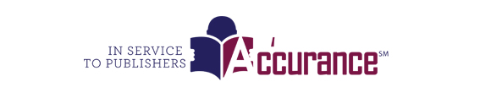


Distribution Portal
Powered by:

Slide 2
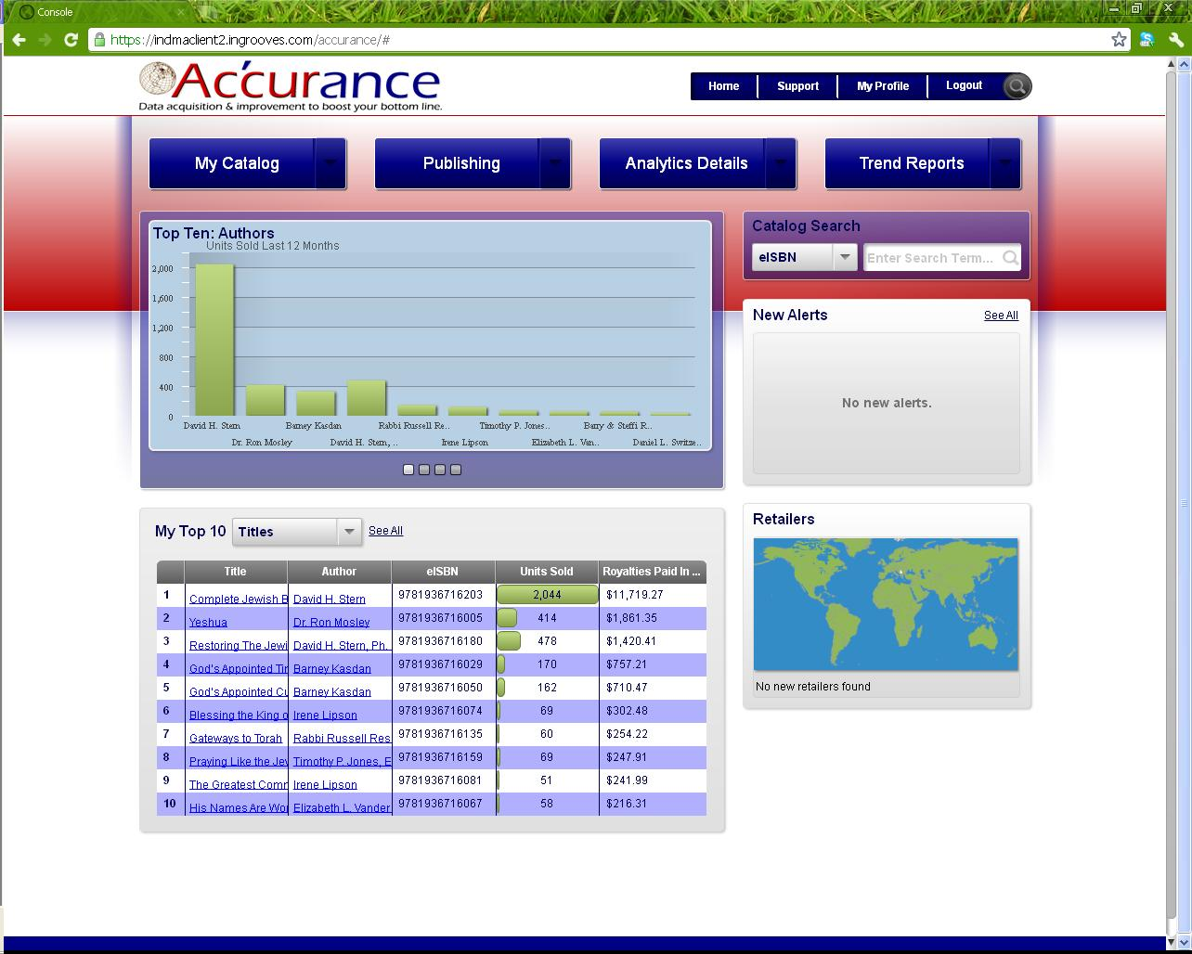
The home page is meant to provide a broad snapshot for your entire catalog with Accurance.
The carousel provides graph data for Top 10 Authors, Titles, Retailers, and Units
The information visually represented in the carousel is detailed in hard data below.

Slide 3
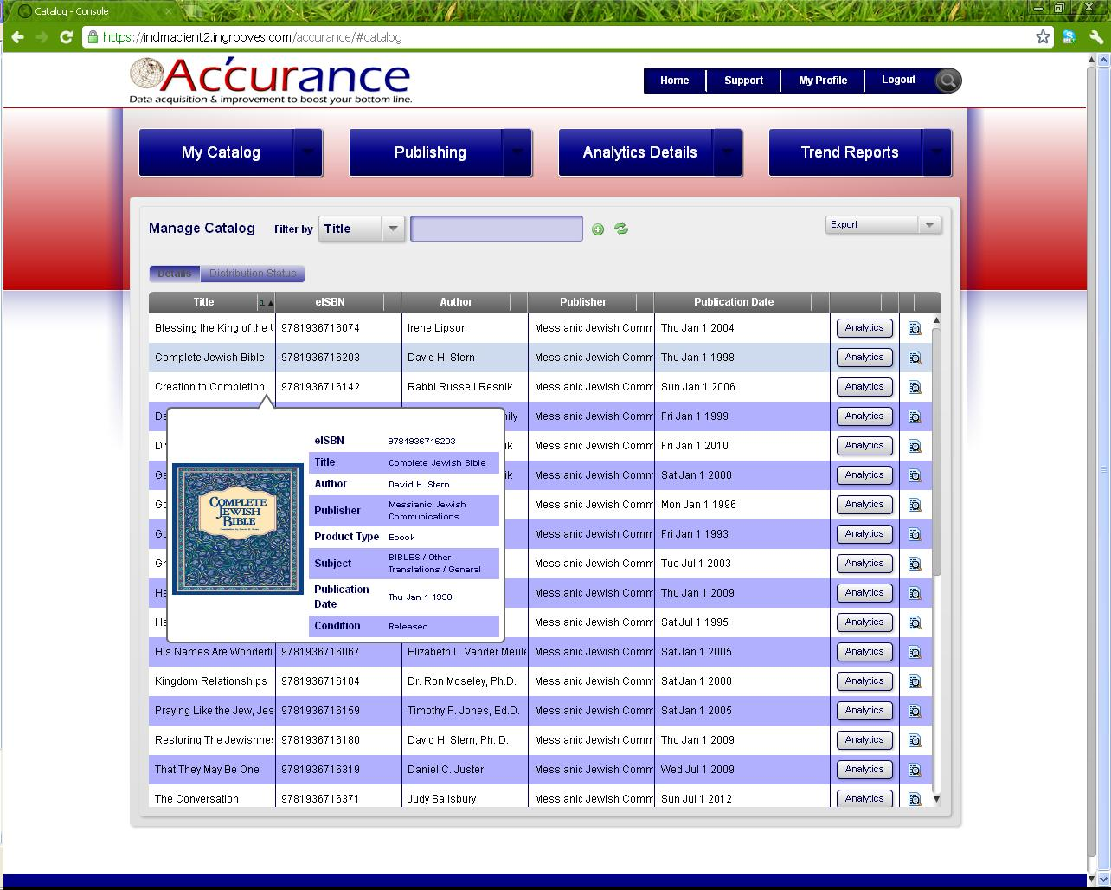
The Catalog Page provides you with an in depth view of all your titles currently in the Accurance system.
You can export this page into an excel document by going to the export drop down and selecting export to CSV.
We often get asked when was my title distributed? For that you will want to go to the Distribution Status button.
You can access your Analytics for an individual title by clicking the “Analytics” button.

Slide 4
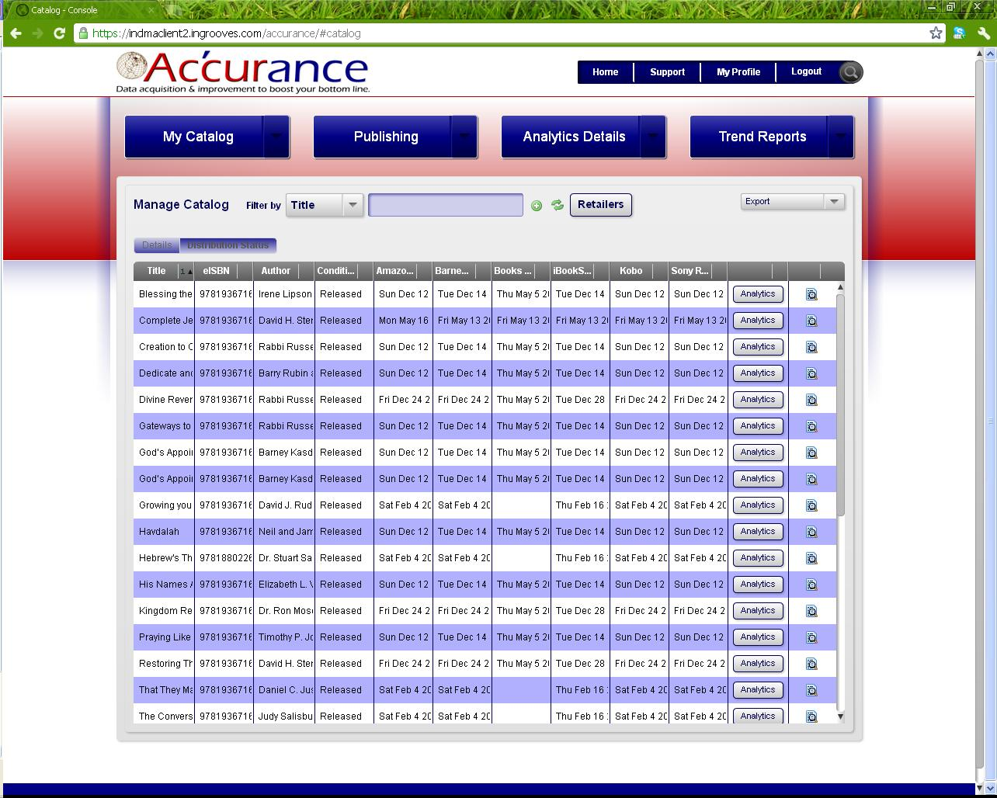
Here you will be able to see the date an individual title was sent to each retailer.
You can export this page into an excel document by going to the export drop down and selecting export to CSV.
Again you can access your analytics for any title by clicking the analytics button.

Slide 5
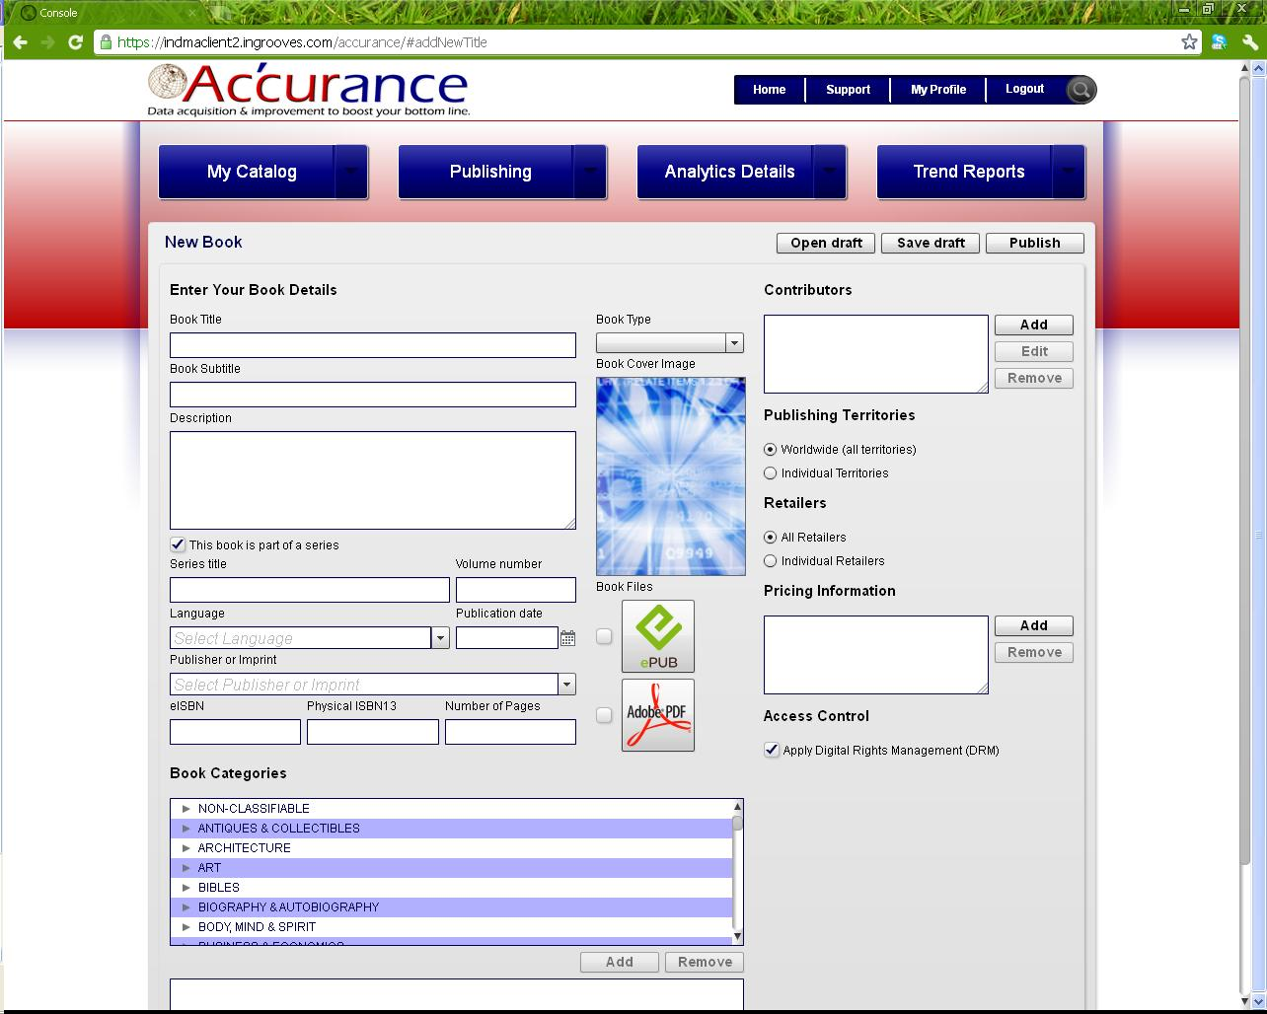
Add your cover image by clicking the blue image window
Tired of filling out the massive excel sheets? The new Accurance online publishing portal displays all the same information in a much more user friendly experience.
Add your epub by click the ePub image and upload (just like including an attachment in an email).

Slide 6
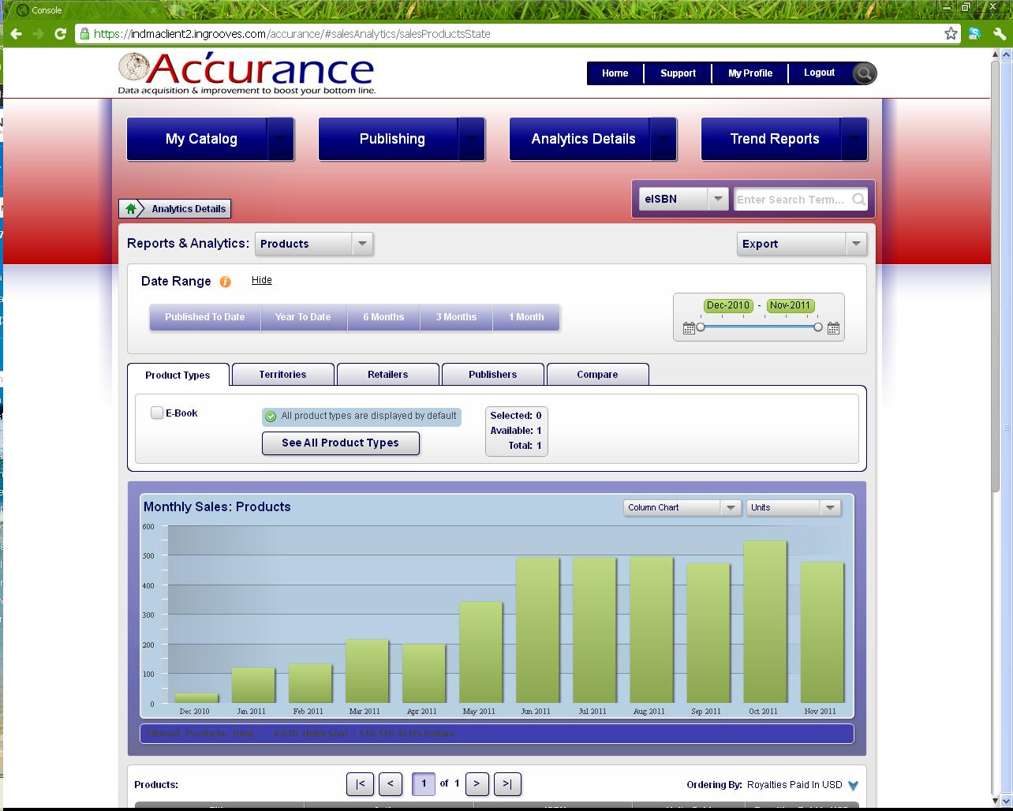
The Analytics Details tab will be your destination to review your ROYALTIES data.
You can export this information as graph as a PDF or hard data into a CSV file.
The information detailed on this page is based of Royalties that have been paid out. So not your recent sales but actual royalties that have been remitted back to you.
You can adjust the date range using the slider

Slide 7
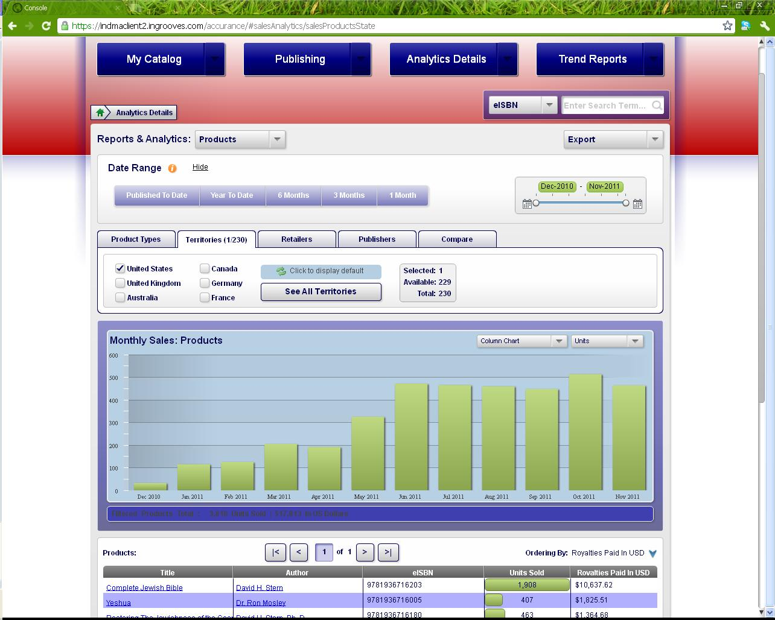
The analytics page allows you to view your royalties in dynamic ways. Isolate specific territories, retailers, imprints, and even compare individual titles to one another.
In this view, we are looking at royalties that have been paid out for sales that occurred in the United States only.

Slide 8
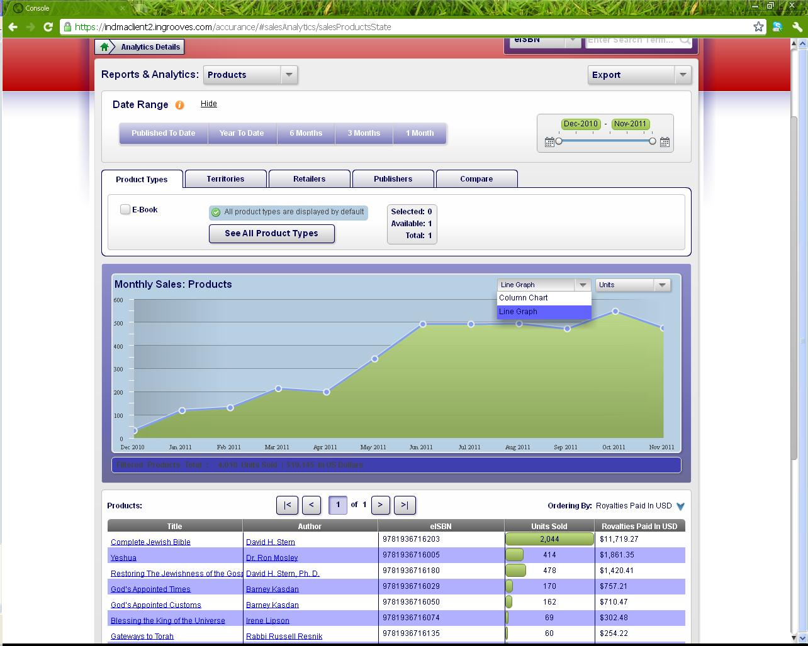
You can also adjust the data and have it display units or dollars sold.
Adjust the graphs from a bar chart (previous screen) to a line graph as you see here.

Slide 9
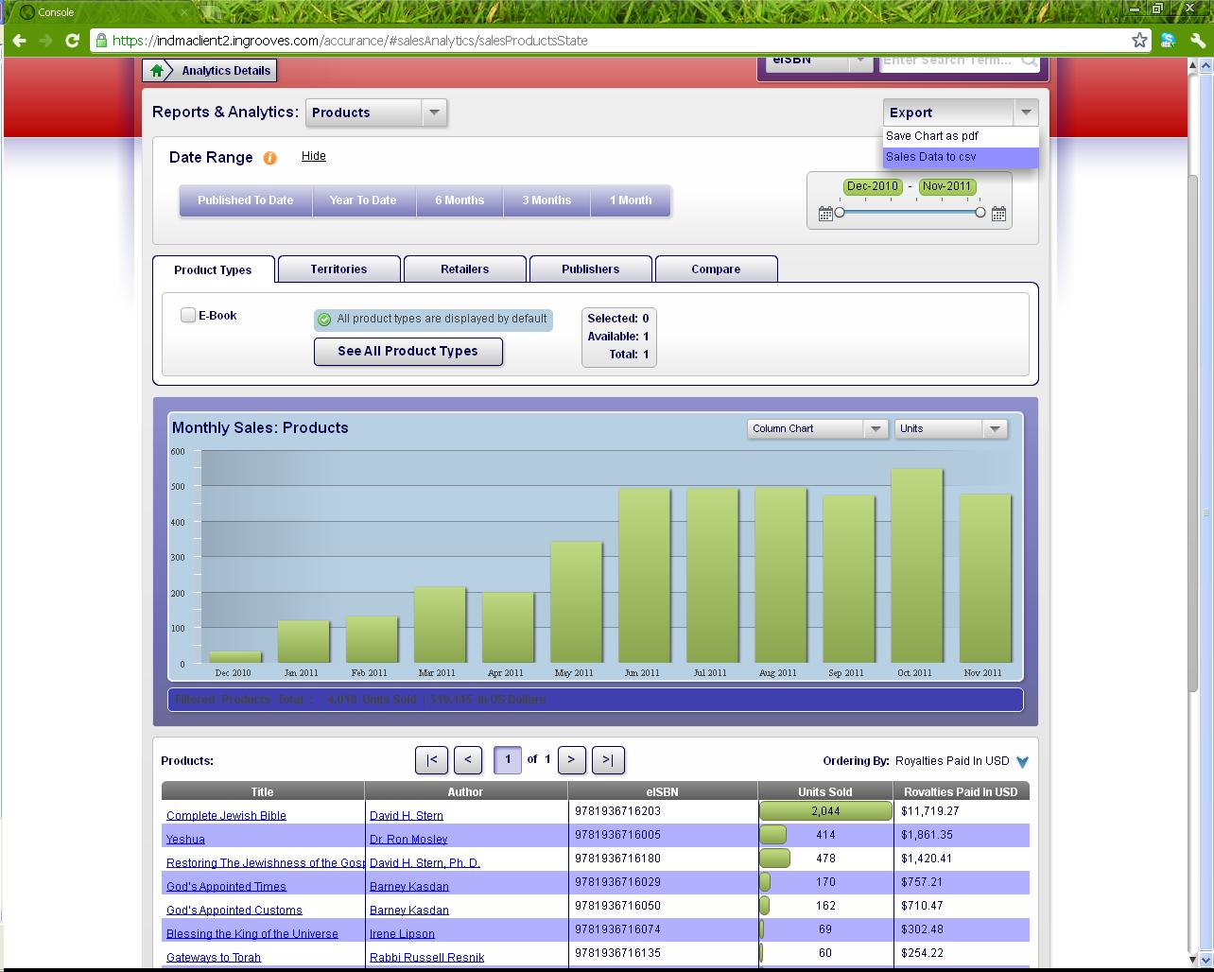
As with all the data housed on your client console, you can export the data as a PDF or CSV file.

Slide 10
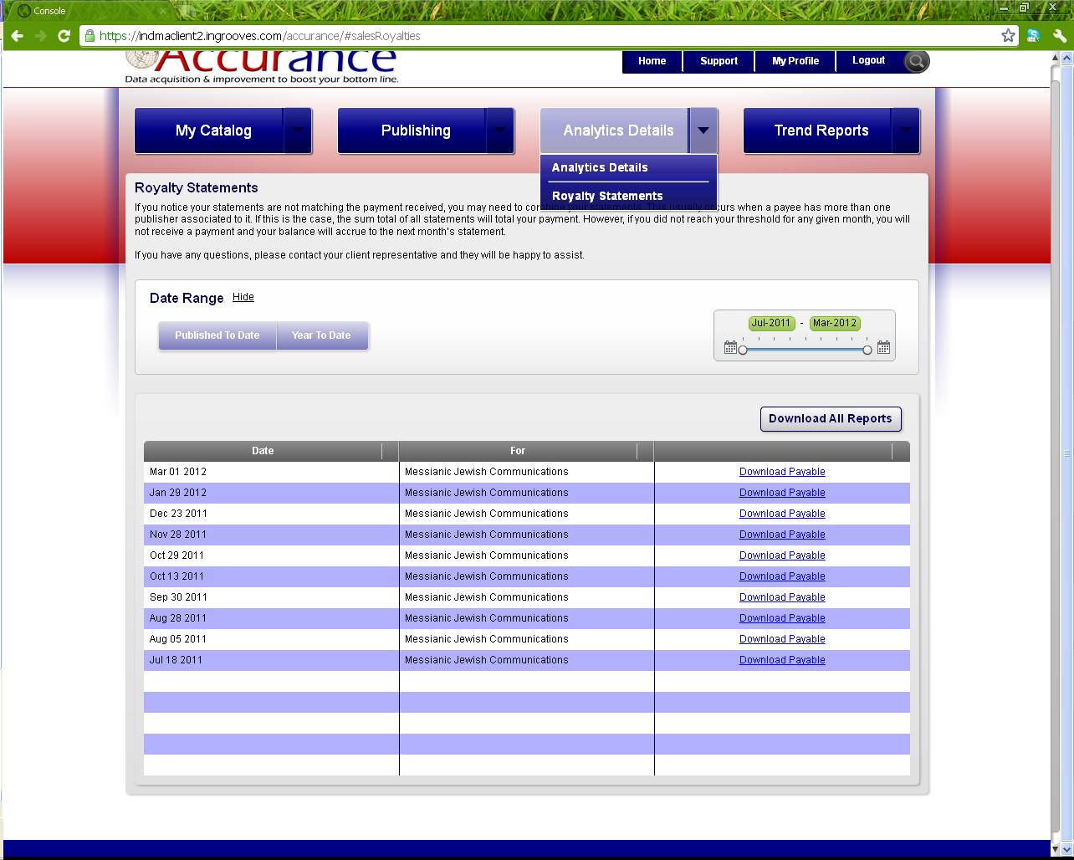
Download your royalties statements into an excel document by clicking the “Download Payable” button.

